Slide 1







Enterprise Blockchain Developers (Intermediate)
In support of
Powered By

Slide 2
Outline
What is Reactjs
Code Demo
Key Concepts
Lifecycle Methods
Functional Component and Hooks
Code Demo
© 2017-2020 SmartMesh Foundation Pte. Ltd. | MeshBox Foundation Pte. Ltd.

Slide 3
What is Reactjs
Reactjs,
It's a library for building user interfaces (UIs)
It creates abstract representations of views. It breaks down parts of the view in the Components. These components encompass both the logic to handle the display of view and the view itself. It can contain data that it uses to render the state of the app
React is divided into two major APIs:
The React Component API: These are the parts of the page that are actually rendered by React DOM.
React DOM: This is the API that's used to perform the actual rendering on a web page.

Slide 4
What is Reactjs
Key Points
JSX: This is the syntax of React components used to describe UI structures.
Lifecycle & lifecycle methods: This consists of methods or Hooks that we implement to respond to the component's entering and exiting phases of the React rendering process as they happen over time. For example, one phase of the lifecycle is when the component is about to be rendered.
Data Passing: props and states, Context API
Routes
Class Component & Functional components
Hooks
forms
uploads
events: These are the code that we write for responding to user interactions.

Slide 5
Code Demo
tasks:
1 setting up reactjs app
2 add nodejs login to react
add routes and link
https://reactrouter.com/web/example/basic
add forms
add events handler
add submit handler
add auth

Slide 6
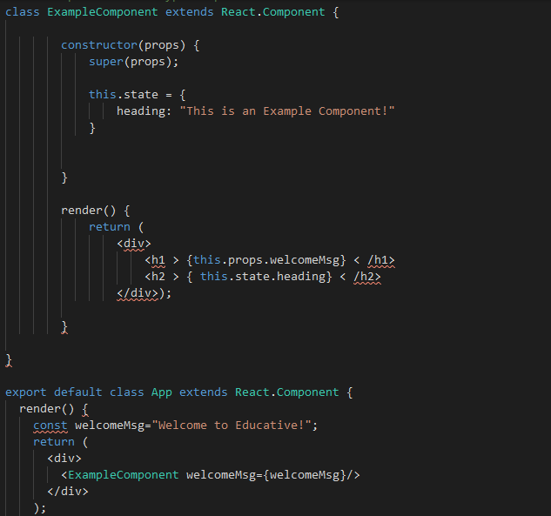
JSX

Slide 7
JSX
 | EJS | JSX
include module | <%- include("navi") %> | <Navi props={pros} />
data passing | no | yes
functions | <scripts> </scripts> but usually we don't write functions directly in ejs templates | can define functions inside of the class or functional components
how to implement | EJS templates are written in the seprate files | JSX are the return of a react component

Slide 8
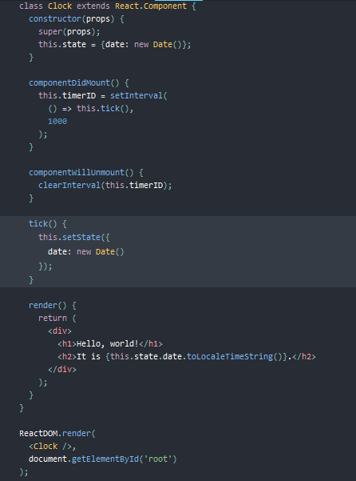
Example

Slide 9
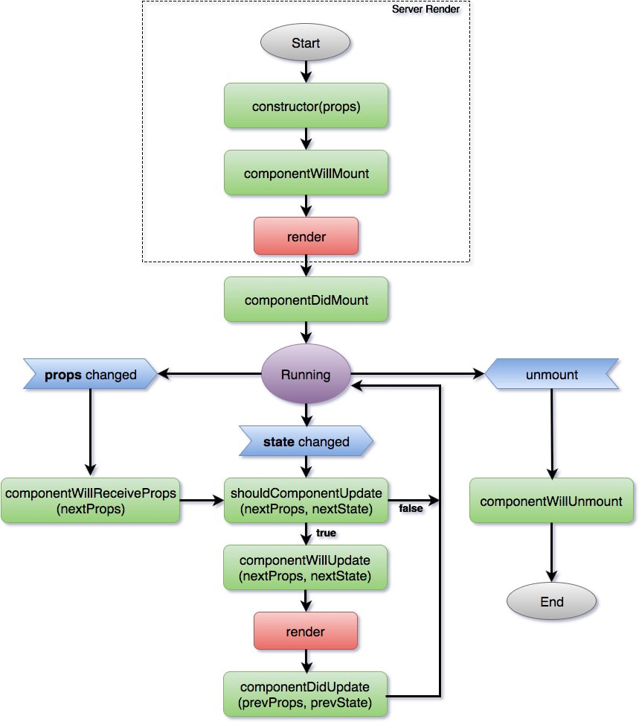
Lifecycle Methods

Slide 10
Lifecycle Methods Code Demo
1 Debug the rendering process (code demo)
2 Transform ejs to jsx (code demo)

Slide 11
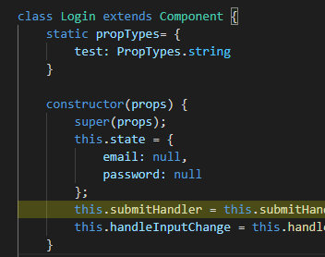
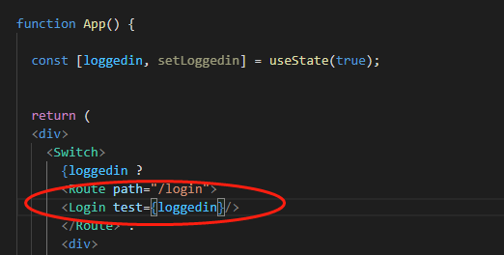
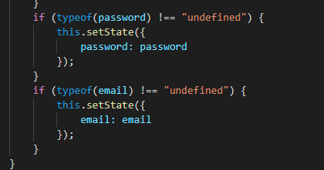
Props vs States
 | Props | States
scope | can be passed among the components | local variables for the component
mutable | props cannot be changed | states can be changed

Slide 12
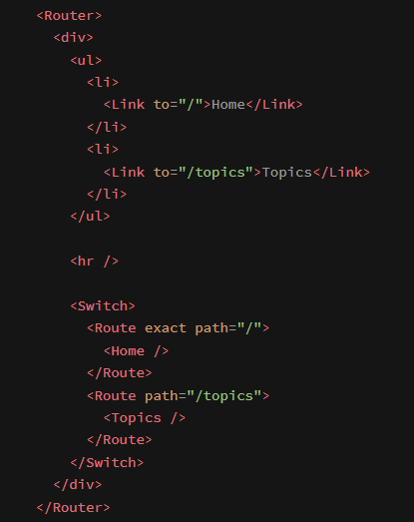
Routes
Reactjs is initailly designed for onepage application
So the route in react is a third party library
1 Nesting

Slide 13
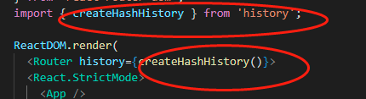
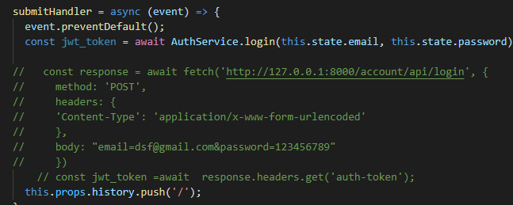
Routes
2 redirect
1) in render html
Link to
2) in code

Slide 14
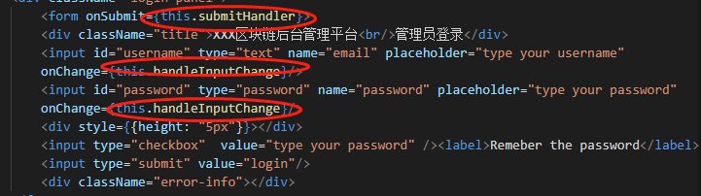


Forms in Reactjs
step 1: add event listener
Features:
every input will invoke the event handler function
step2 create a event handler function to deal with data
preventDefault

Slide 15
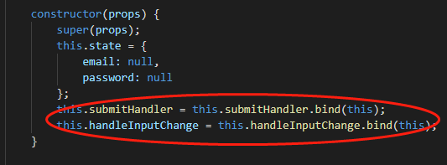
Bind in Reactjs
Step 3 add bind
What is bind? and why we need to use Bind?
when passing down to the child component, this would probabily be change, so need to bind this

Slide 16
Functional Component and Hooks
Hooks, an API that allows your functional components to "Hook" into React functionality.
The overarching motivation for this feature is to simplify your components. For example, forcing React developers to use classes to define their components leads to the overuse of wrapper components to pass state around their apps.
With Hooks, you can stick with simple functions to implement your components and have a clear picture of how everything fits together.
Functional Component: more flexible and simpler than Class Component
1.Functional Components also known as Stateless component
2.Class Component also known as Stateful component
how to use hooks?

Slide 17
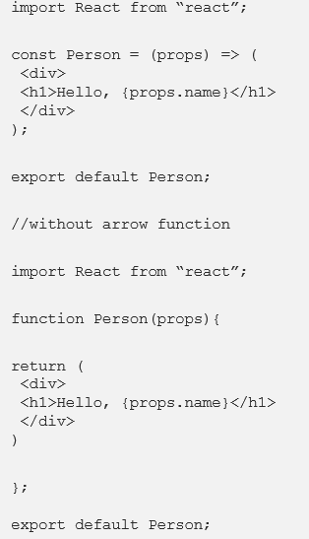
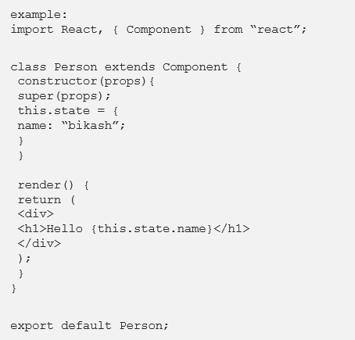
Code Demo

Slide 18
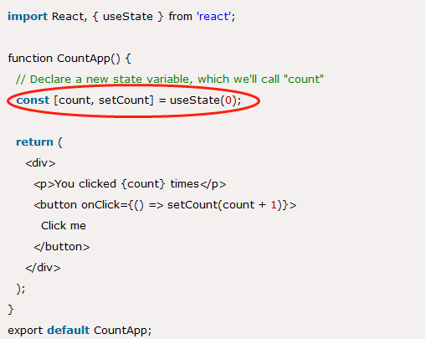
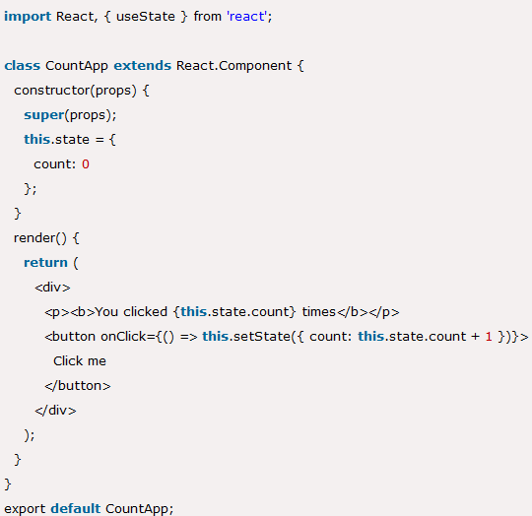
Hook Code Demo

Slide 19
Hook Code Demo
Two ways of defining functional States
const [age, setAge] = useState(19)
const [name, setName] = useState(“John”)
const [status, setStatus] = useState({
age: 19,
name: “John“
})
When update:
setStatus({
age: 12,
name: “John“
})

Slide 20
Code Demo
3 add routes to the reactjs app (code demo)
4 add auth 1 (code demo)
5 how to pass the data (code demo)

Slide 21
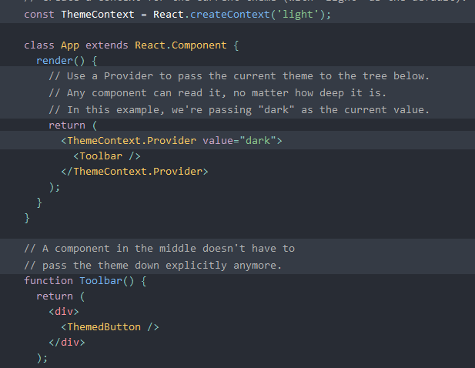
Context
Context acts as global variables, comparing with props and states (draw diagram)

Slide 22
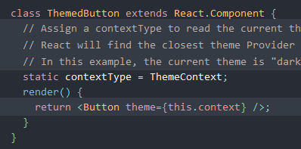
Context
Implimentation 1

Slide 23
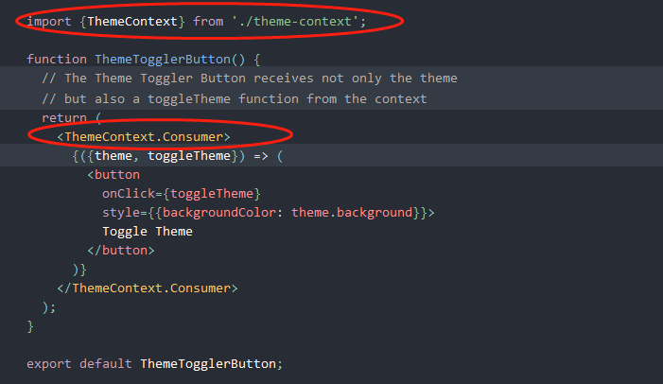
Context
Implimentation 2

Slide 24
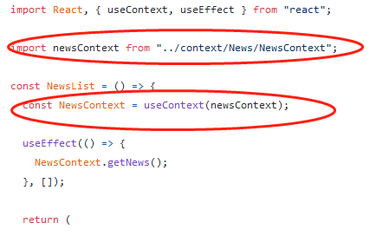
Context
Implimentation 3

Slide 25
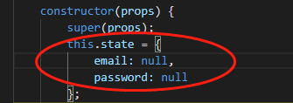

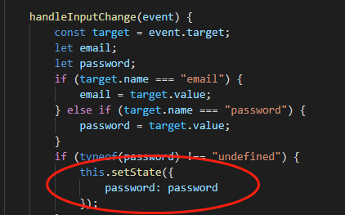
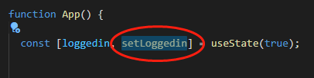
Functional Component vs Class Component
1 State
2 setState

Slide 26
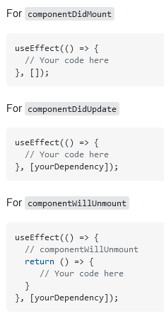
Functional Component vs Class Component
3 componentDidMount vs useEffect
2 Context (covered)

Slide 27
Route Link and Redirect
react-router-dom
is a third-party context
In a functional component, we use useHistory to invoke it; while in a class component we use withRoute to invoke it
history.push = Link in html
history.replace = Redirect in html

Slide 28
Code Demo
1 add auth 2 client side(localStorage vs cookie, how to implement)
2 change class to functional component

